Slide 1
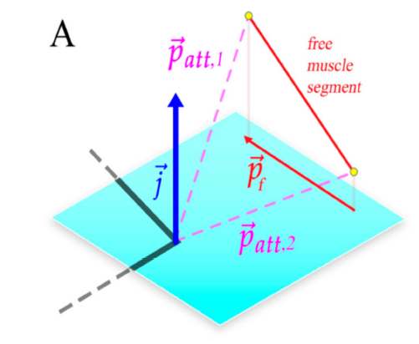
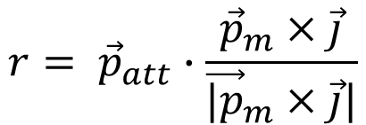
June 1st Updates:
To calculate muscle force for desired joint torque, we need calculate muscle moment arms during walking.
The process are pretty similar to Fletcher’s work, except for two changes:
I only calculate muscle segment that spam through joints.
Muscle segment are not projected on to joint rotation plane, moment arms are now calculate base on the shortest distance between muscle segment vector and joint rotation axis.
$$r= {\vec{p}}_{att}∙\frac{{\vec{p}}_{m}×\vec{j}}{{\vec{|p}}_{m}×\vec{j}|}$$
(Fletcher et.al 2019)

Slide 2
Extension muscle moment arm shape are similar with joint angle, while flexion muscle moment arm shape are inverse of joint angles.
BFP muscle have large moment arm for both hip and knee joint when compare to other muscles due to it biomechanical configuration.
GA and SO moment arm are similar for the ankle joint and inverse shape of TA muscle moment arm.

Slide 3
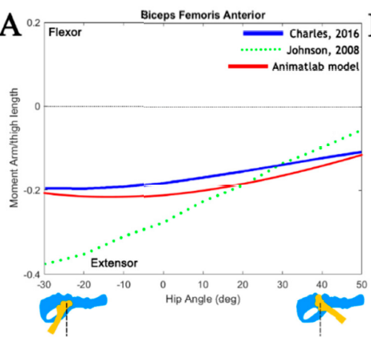
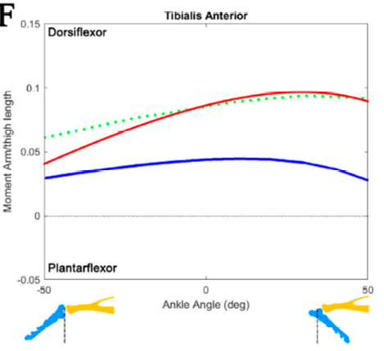
When compare with Fletcher’s work and other, the BFA muscle are nearly identical.
While the TA muscle are a bit shifted up.

Slide 4
Solving for muscle force
As we calculated the muscle moment arms, and we got desired joint torque, we can solve for desired muscle tension.
Unknowns: Tension [T1 T2 T3 T4 T5 T6 T7]
Equations:
$${Eq1: T}_{1}∗r_{1}+T_{2}∗r_{2}+T_{7}∗r_{7}+T_{8}∗r_{8}−{Torque}_{Hip}=0$$
$${Eq2: T}_{3}∗r_{3}+T_{8}∗r_{8}′+T_{2}∗r_{2}′+T_{4}∗r_{4}−{Torque}_{Knee}=0$$
$${Eq3: T}_{4}∗r_{4}′+T_{6}∗r_{6}+T_{5}∗r_{5}−{Torque}_{Ankle}=0$$
I tried use fsolve to calculate the muscle force, but can’t converge to a steady solution.
Bisect returns NaN, trying to find a new way using cost function.
$$Objective=1e6∗\left(Eq1^{2}+Eq2^{2}+Eq3^{2}\right)+1e3∗constraints$$
(Daniel 2012)

